Slide 1
Tutorial Machine Learning in Solid Mechanics
Task 1: Feed-forward neural networks
Xin Xiong ,Huasen Luo
November 5, 2024

Slide 2
Agenda
1
Evaluation results of different numbers of hidden layers
2
Evaluation results of different numbers of nodes
3
Evaluation results of different numbers of epochs
4
Evaluation results of different activation functions
5
Compare FFNN with ICNN
6
Sobolev training

Slide 3
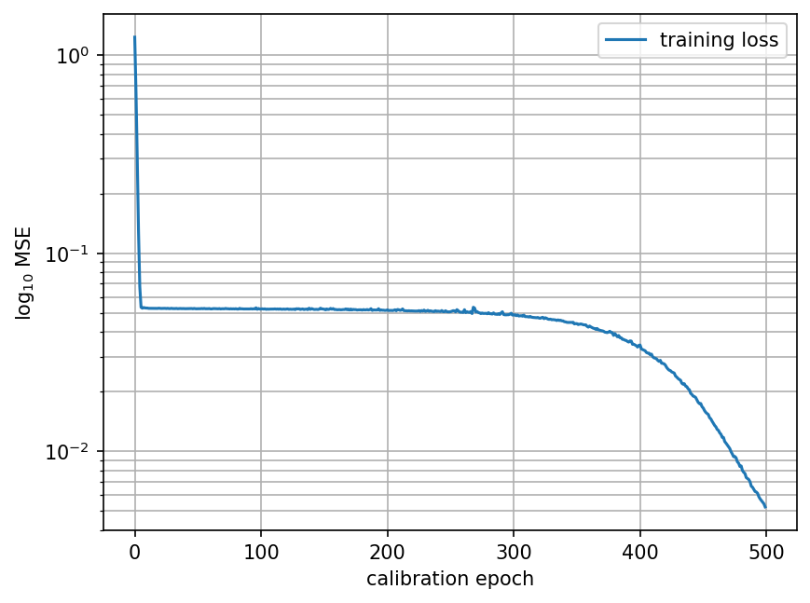
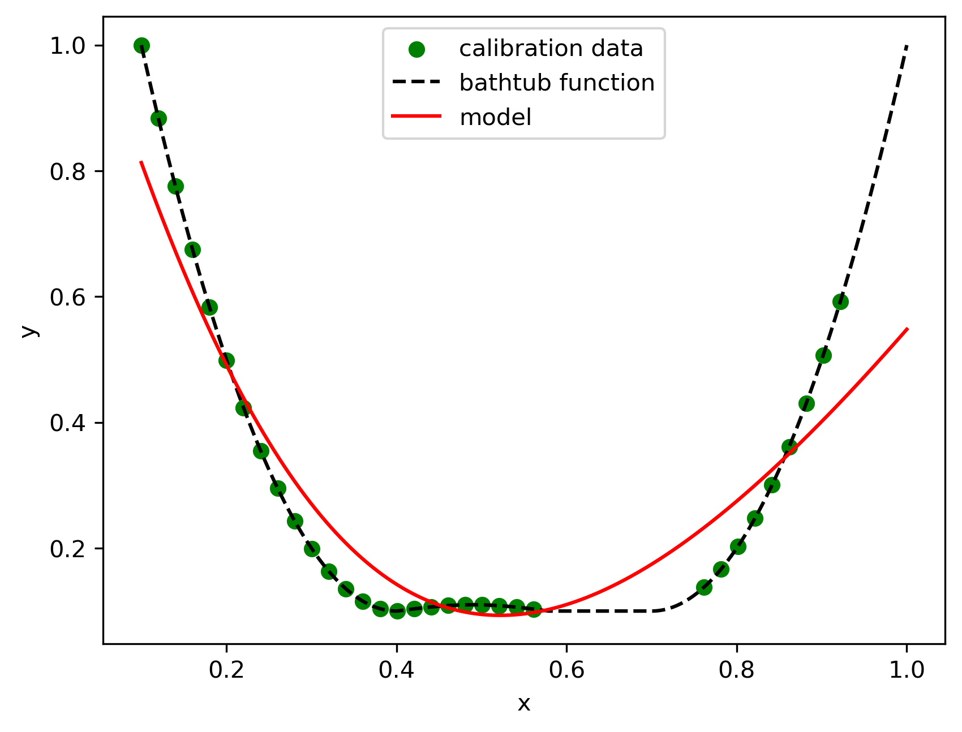
1. Evaluation results of different numbers of hidden layer
1 layer (16 nodes, 500 epochs) :

Slide 4
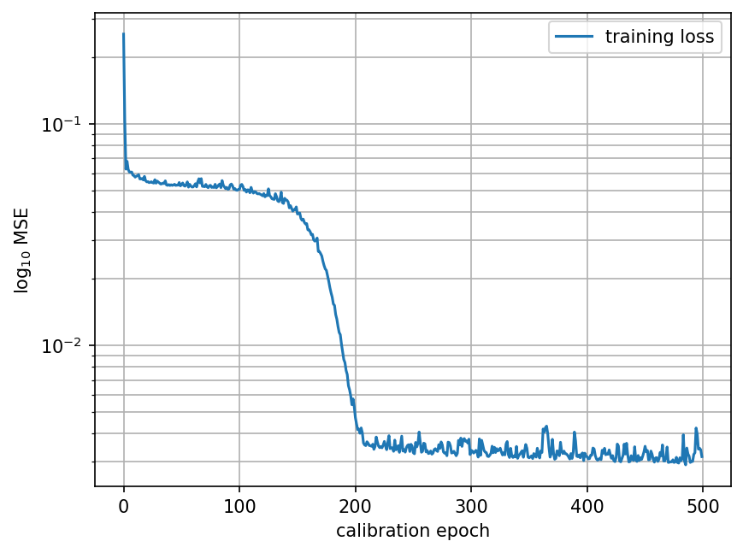
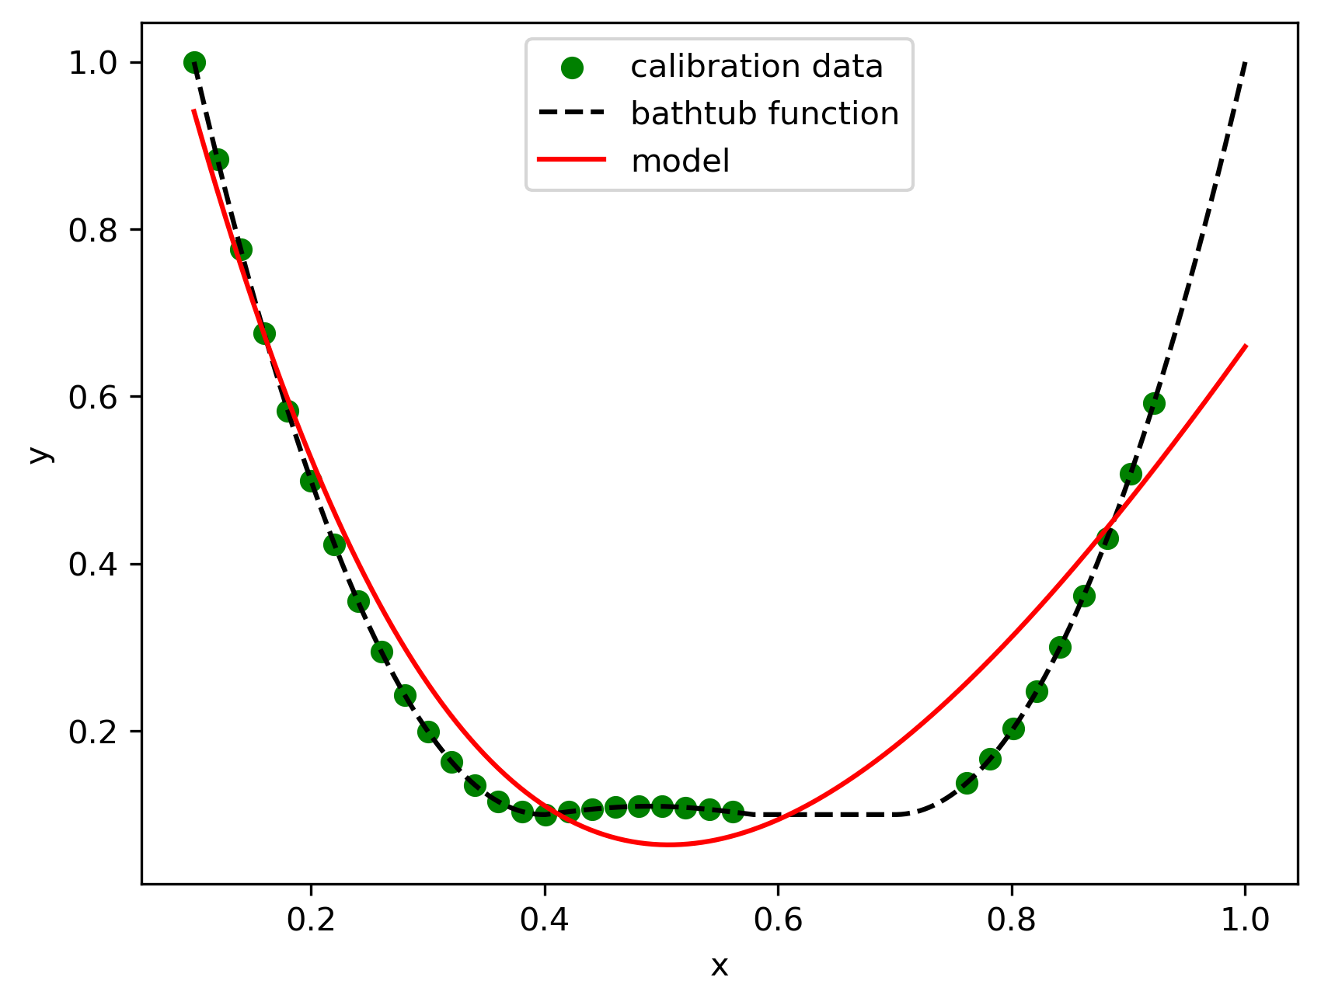
1. Evaluation results of different numbers of hidden layers
2 layers (16 nodes, 500 epochs) :

Slide 5
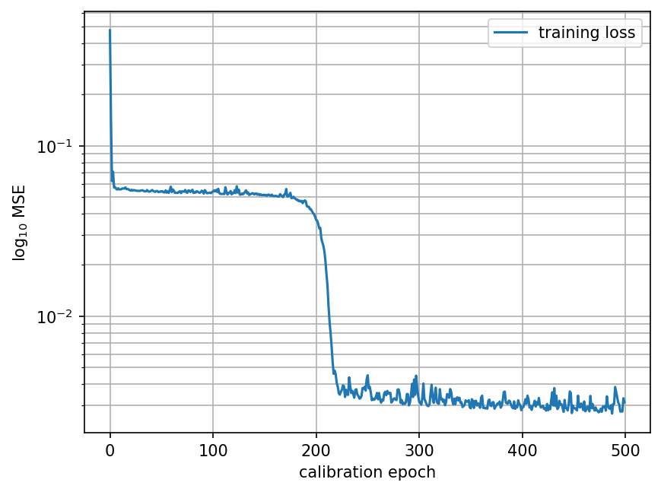
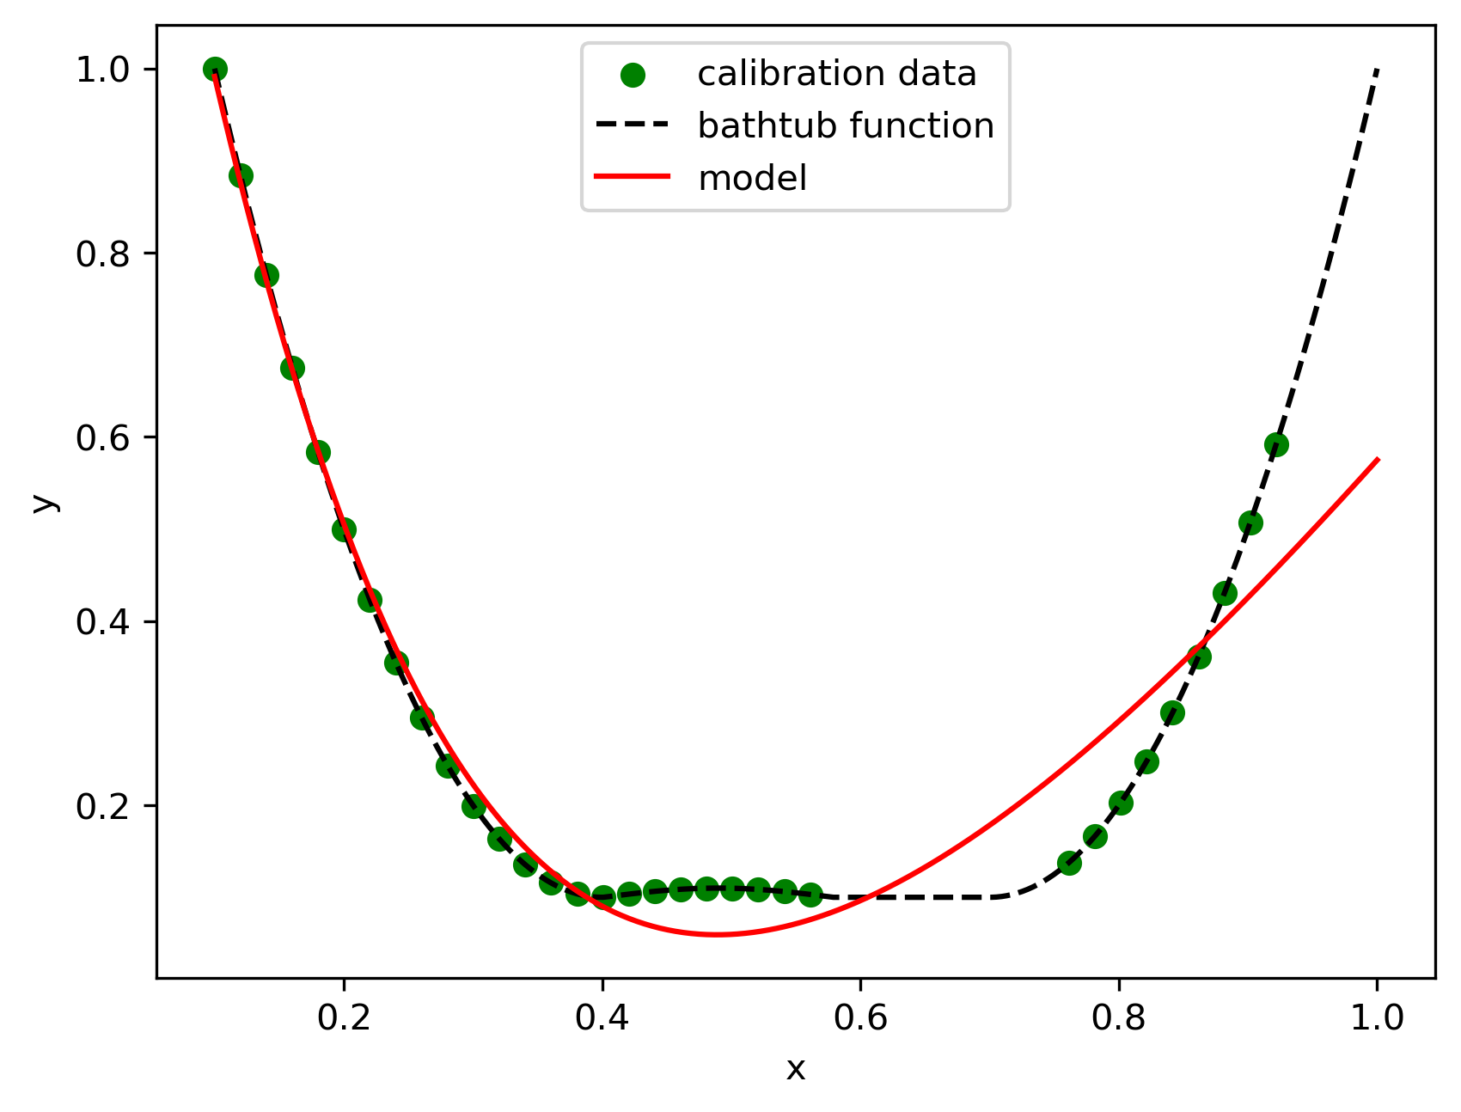
1. Evaluation results of different numbers of hidden layers
3 layers (16 nodes, 500 epochs)

Slide 6
1. Evaluation results of different numbers of hidden layers
Observation :
1 hidden layer has faster training times but potentially higher errors on complex tasks
2 hidden layers can capture more complex patterns than a single layer without excessive overfitting risk.
3 hidden layers allows for learning more intricate patterns and interactions within the data.

Slide 7
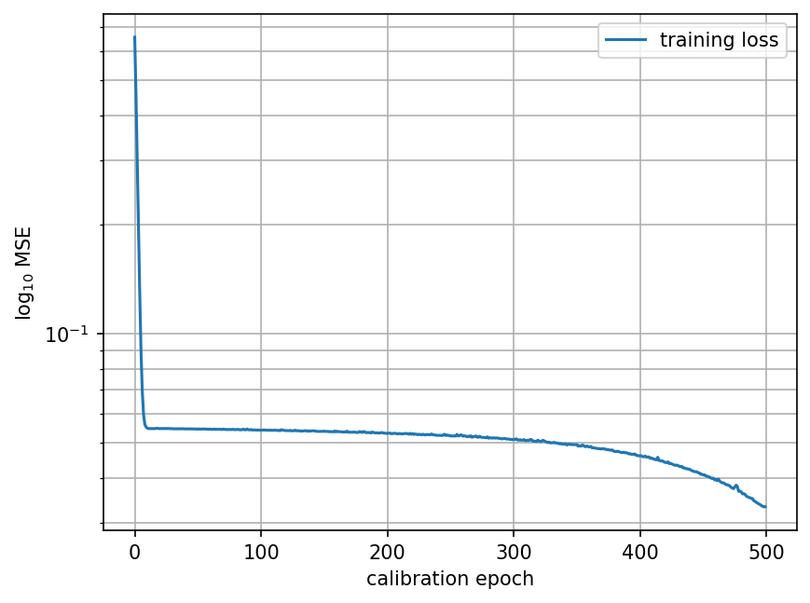
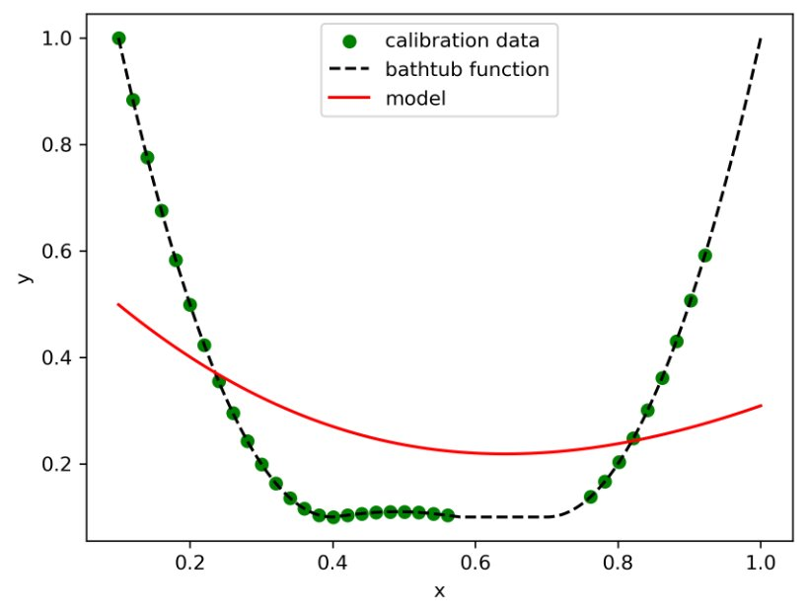
2. Evaluation results of different numbers of nodes
4 nodes(1 layer, 500 epochs) :

Slide 8
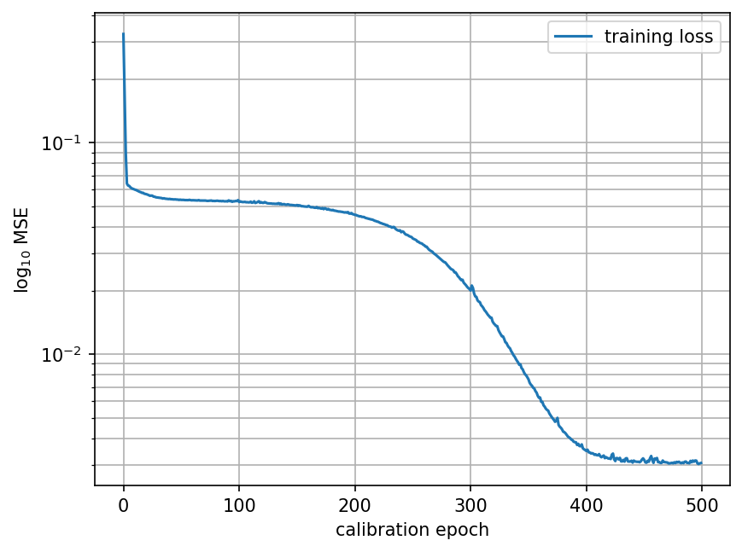
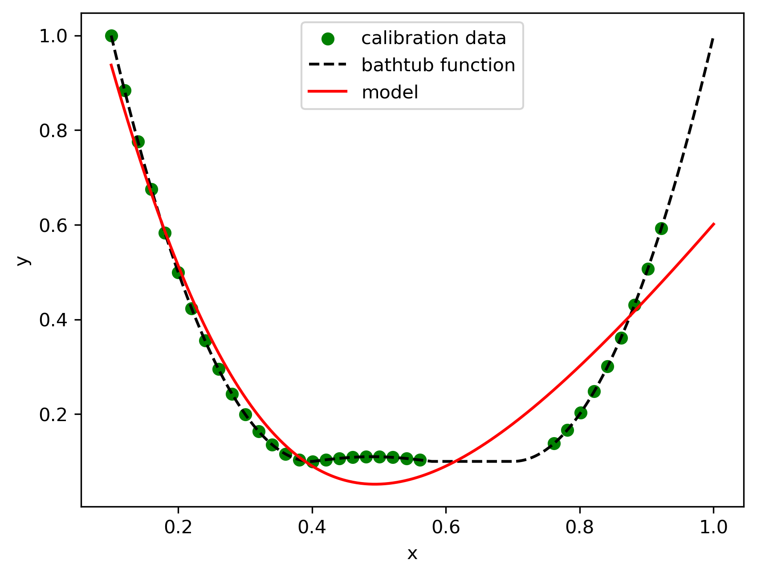
2. Evaluation results of different numbers of nodes
8 nodes(1 layer, 500 epochs) :

Slide 9
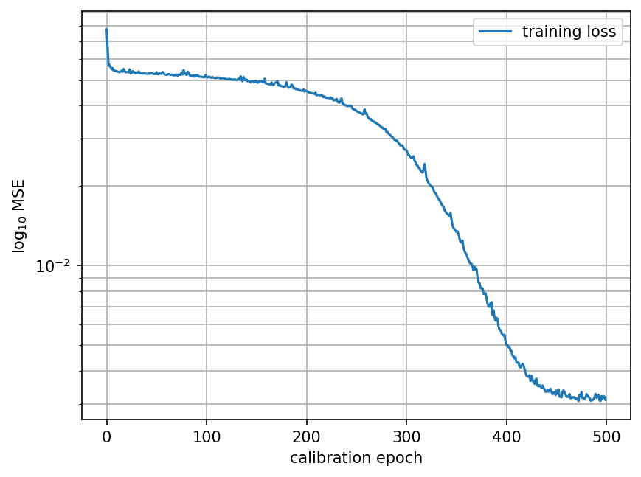
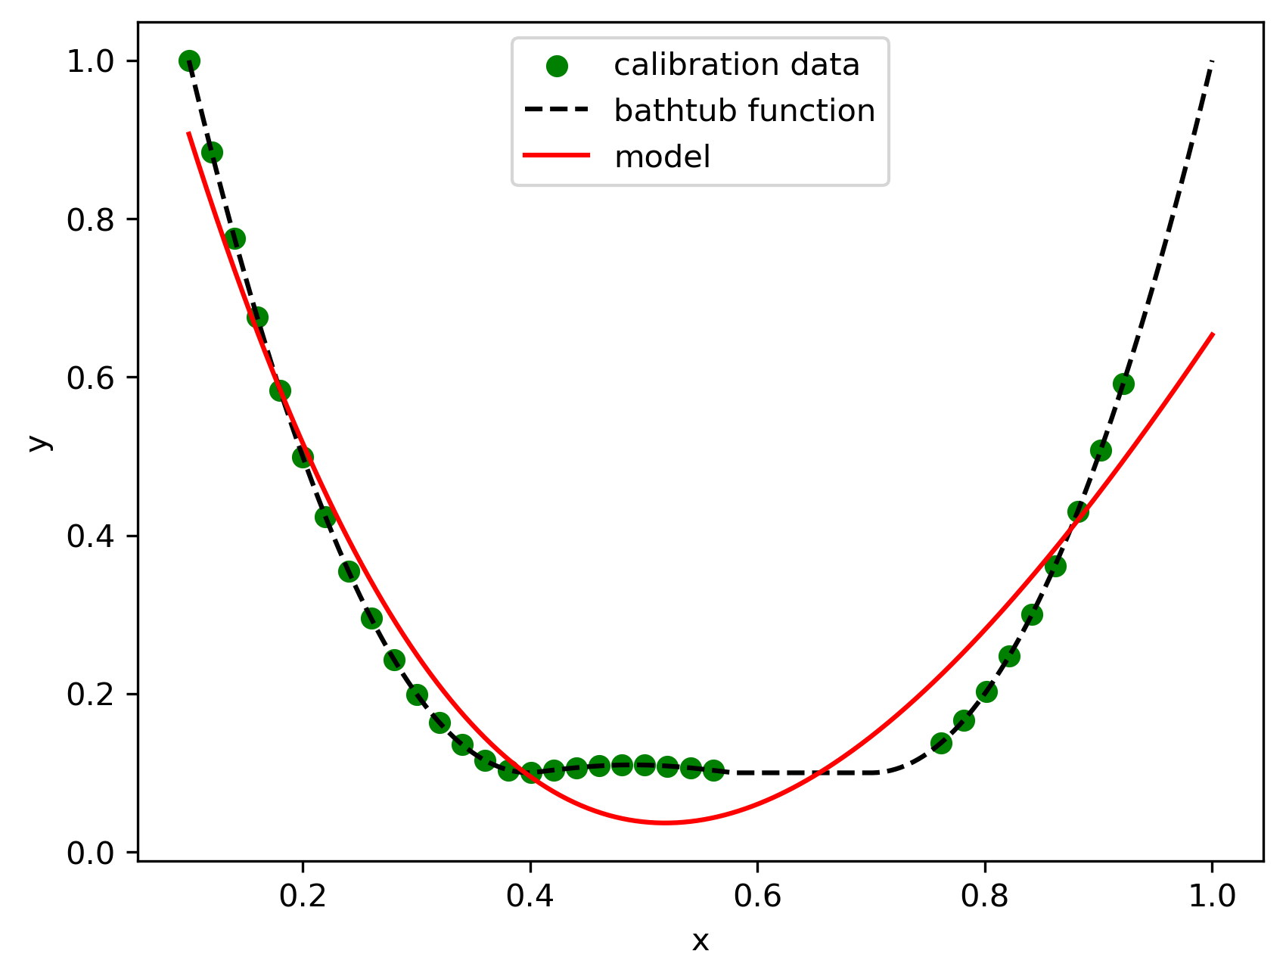
2. Evaluation results of different numbers of nodes
16 nodes(1 layer, 500 epochs) :

Slide 10
2. Evaluation results of different numbers of nodes
Observation :
4 nodes has limited capacity to represent complex functions.
8 nodes offers better performance and can generalize well with appropriate training.
12 nodes have higher representation capacity that can capture detailed data patterns, potential risk of overfitting

Slide 11
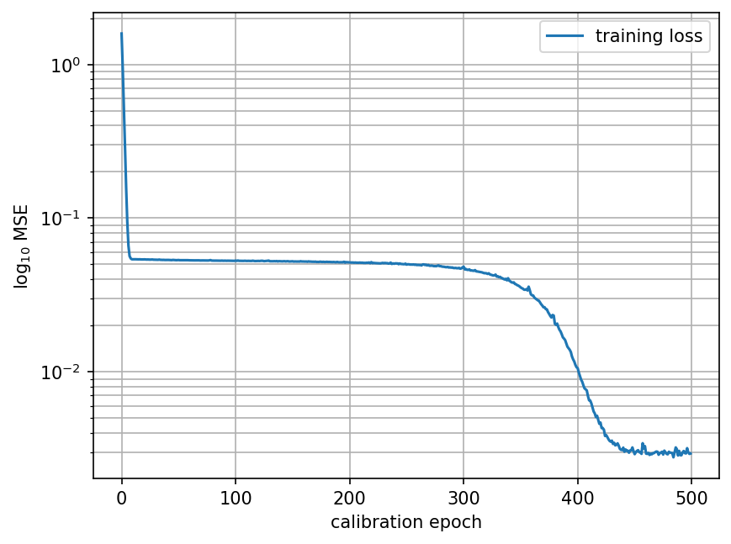
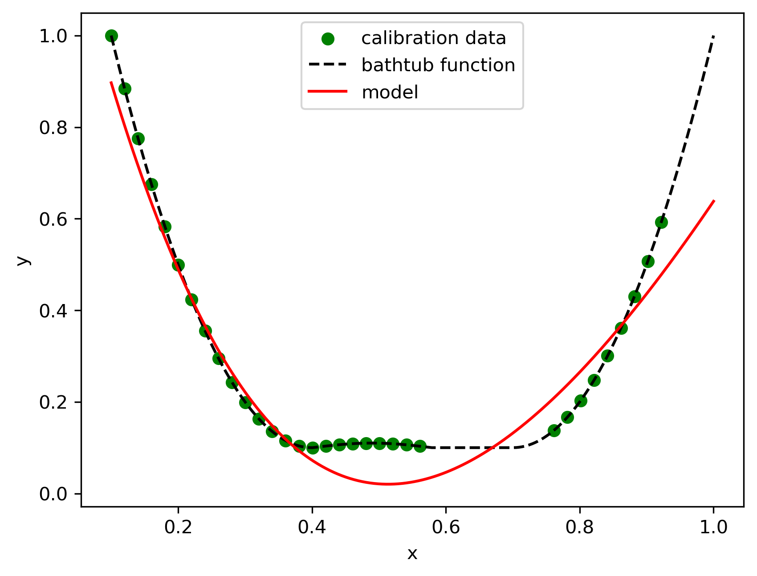
3. Evaluation results of different numbers of epochs
500 epochs (2 layers, 8+4 nodes) :

Slide 12
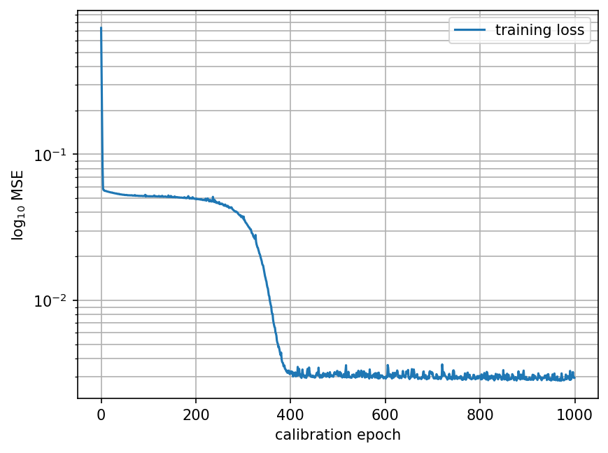
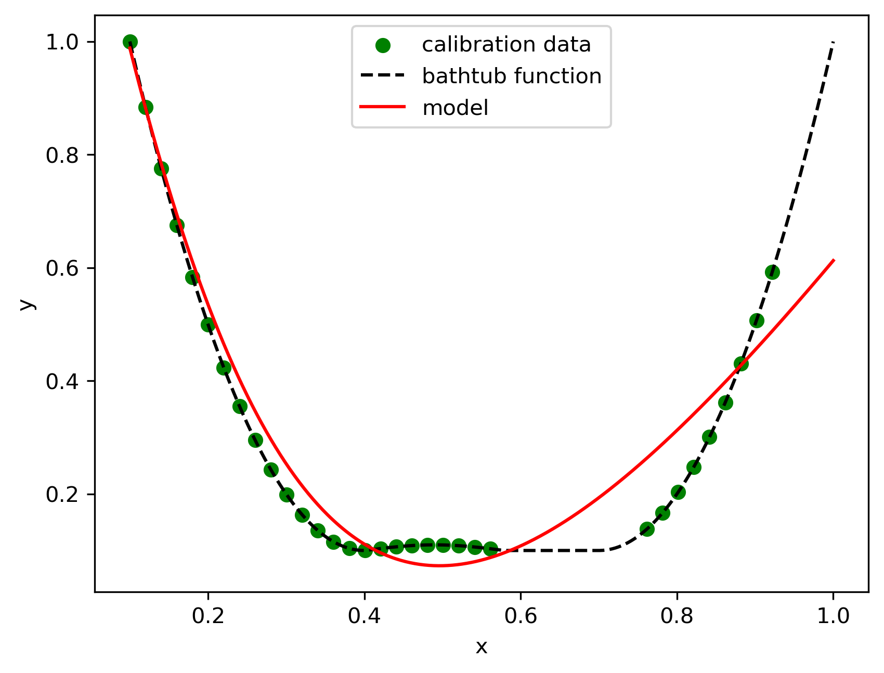
3. Evaluation results of different numbers of epochs
1000 epochs (2 layers, 8+4 nodes) :

Slide 13
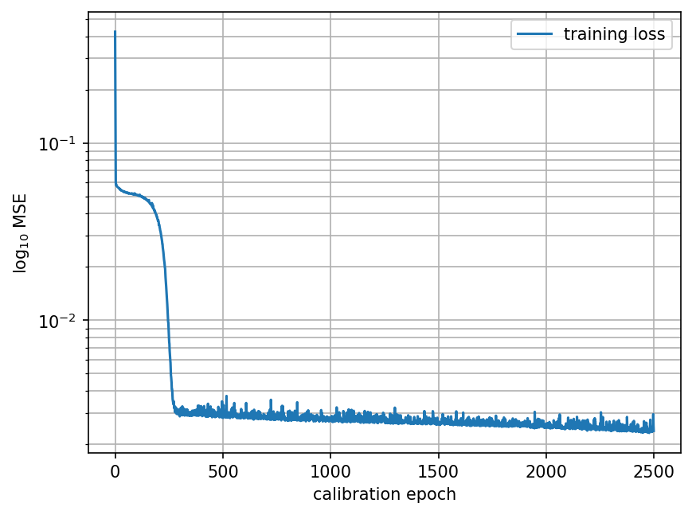
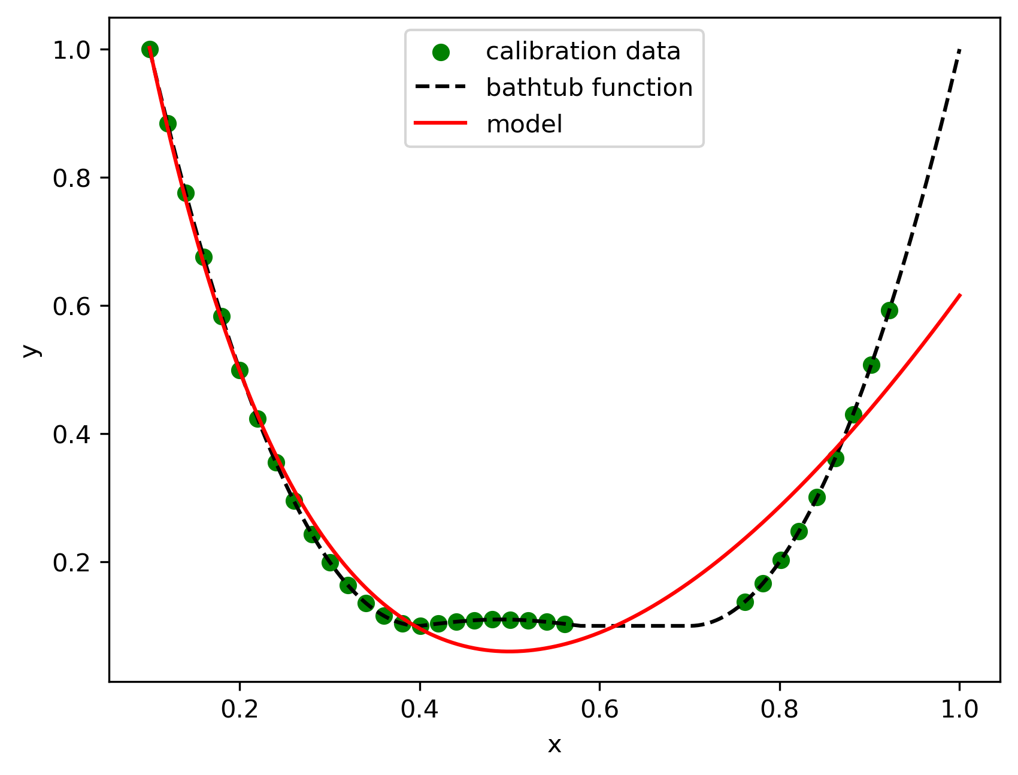
3. Evaluation results of different numbers of epochs
2500 epochs (2 layers, 8+4 nodes) :

Slide 14
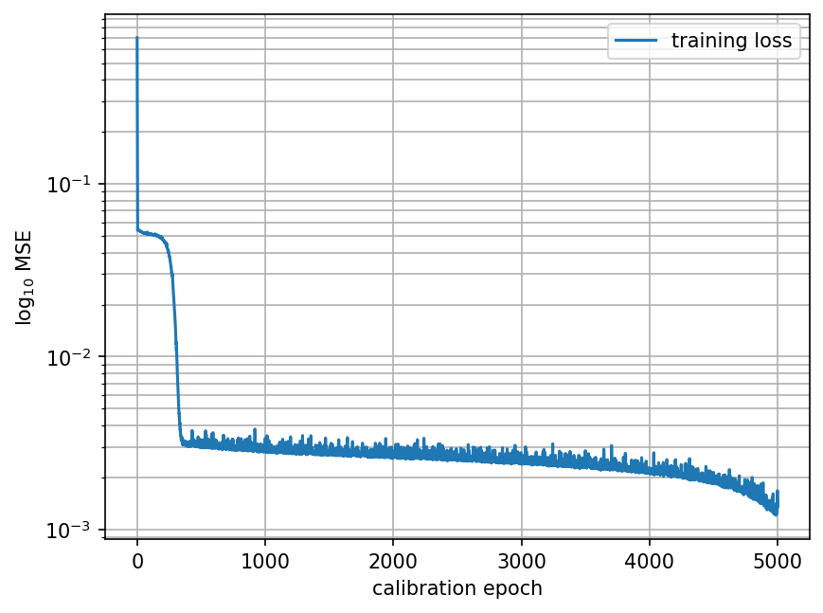
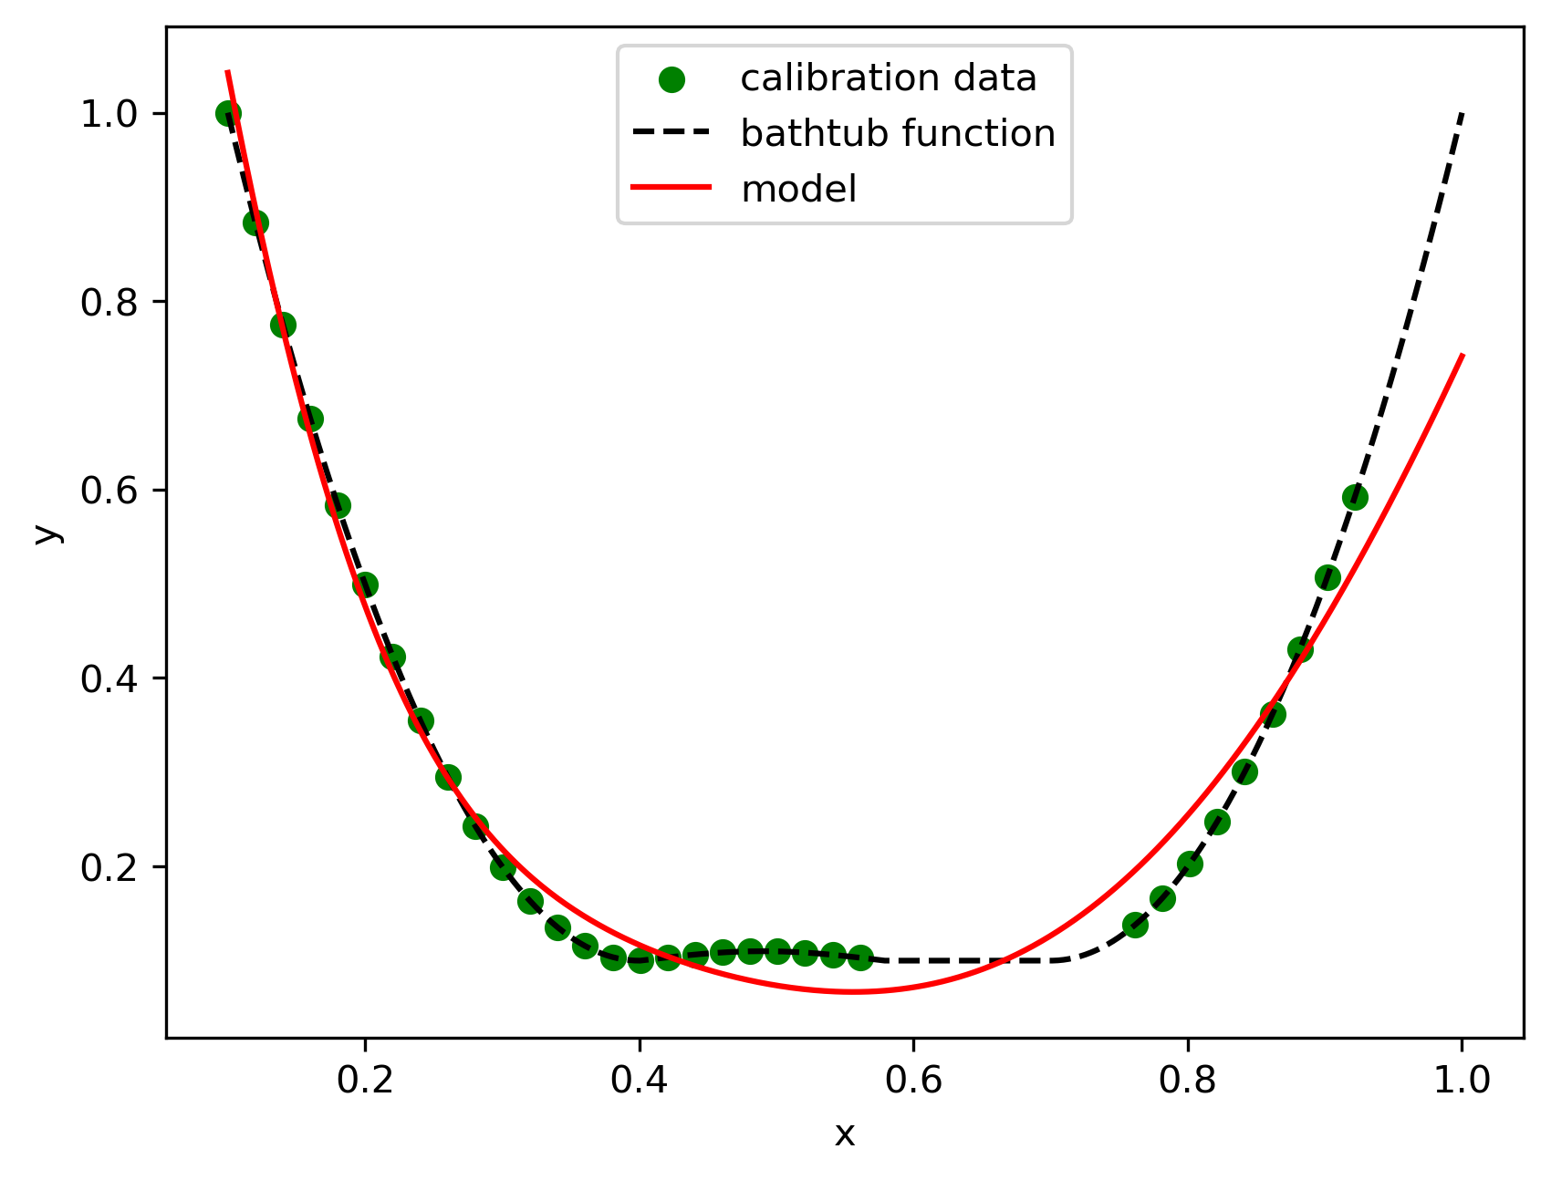
3. Evaluation results of different numbers of epochs
5000 epochs (2 layers, 8+4 nodes) :

Slide 15
3. Evaluation results of different numbers of epochs
Observation :
500 epochs have fast training time but may not fully converge,
1000 epochs have training time that allows the model to learn better patterns and reduce error.
2500 epochs has more time leading to higher accuracy.
5000 epochs have very thorough training leading to the best possible fit for complex models but with a risk of overfitting if monitored incorrectly.

Slide 16
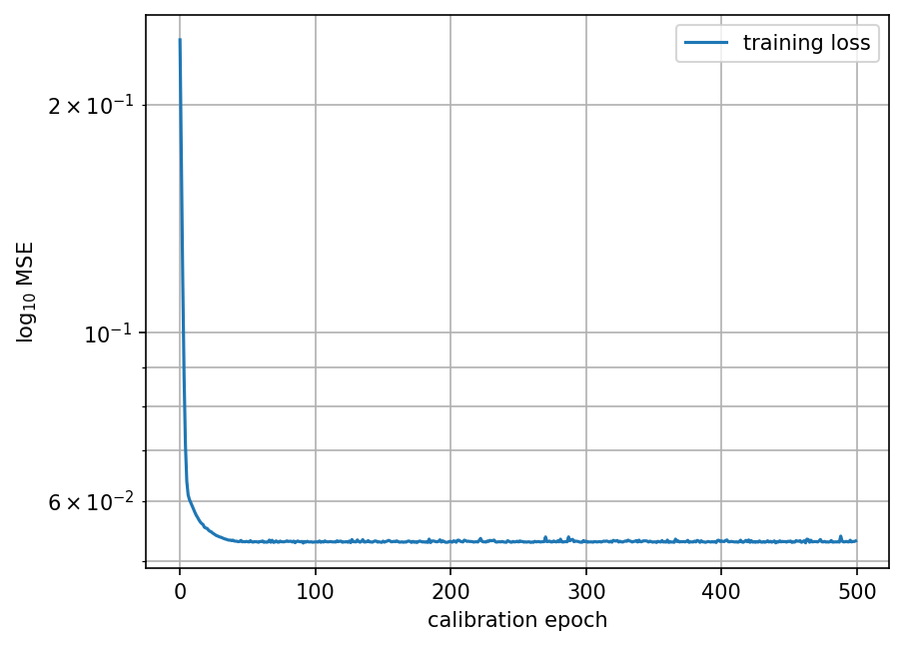
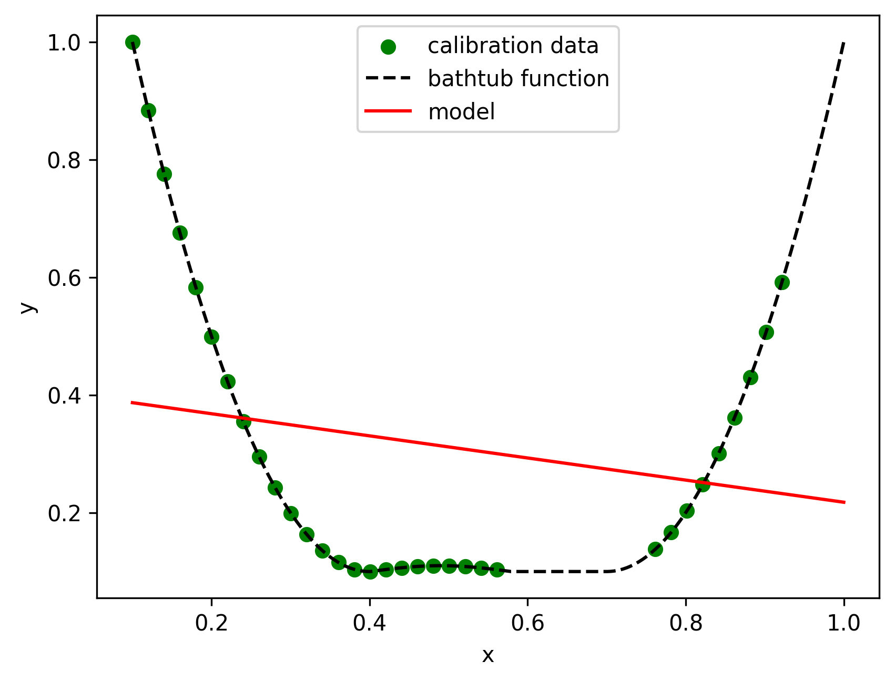
4. Evaluation results of different activation functions
Activation Function : Relu (1 layer, 16 nodes)

Slide 17
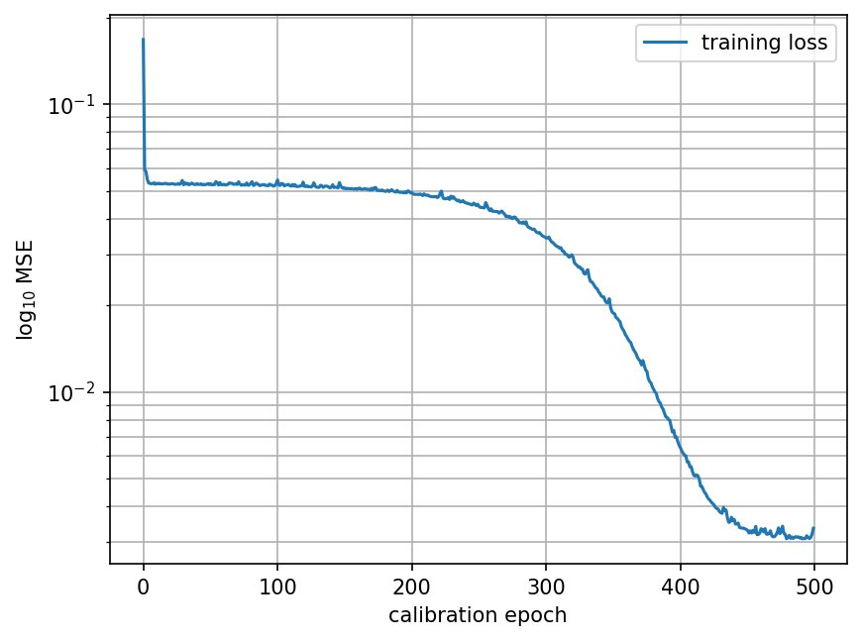
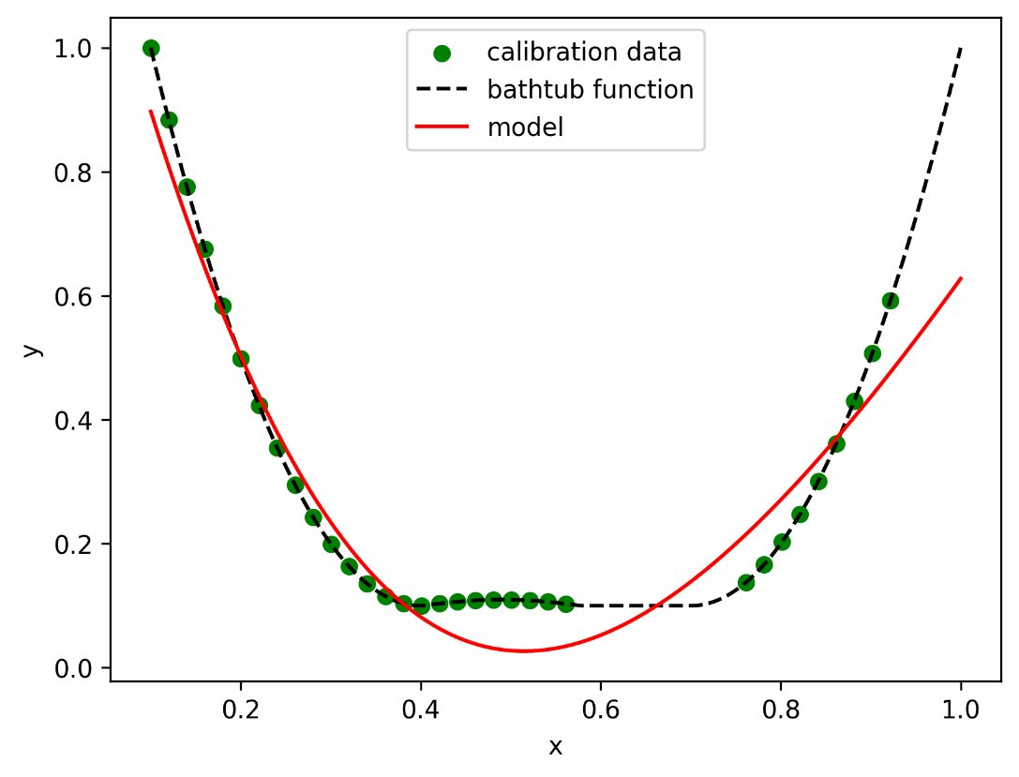
4. Evaluation results of different activation functions
Activation Function : Softplus (1 layer, 16 nodes)

Slide 18
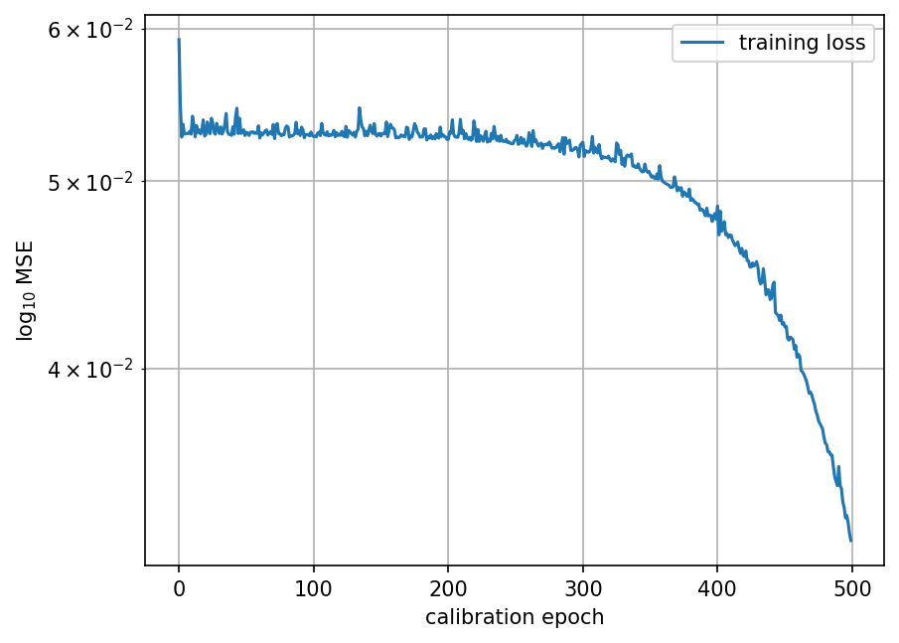
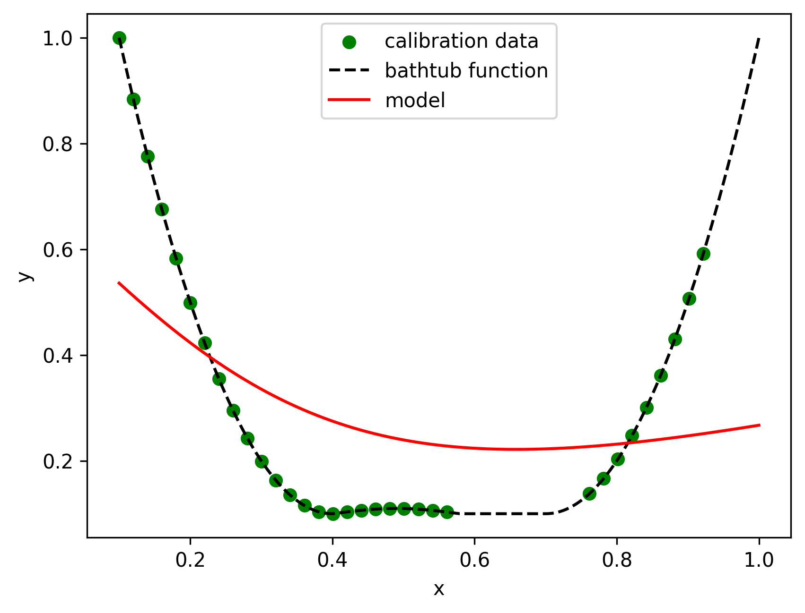
4. Evaluation results of different activation functions
Activation Function : Sigmoid (1 layer, 16 nodes)

Slide 19
4. Evaluation results of different activation functions
Observation :
ReLU has simplicity and ability to mitigate vanishing gradient issues.
Softplus outputs continuous derivatives, leading to potentially smoother training.
Sigmoid suffers from vanishing gradients in deeper networks.

Slide 20
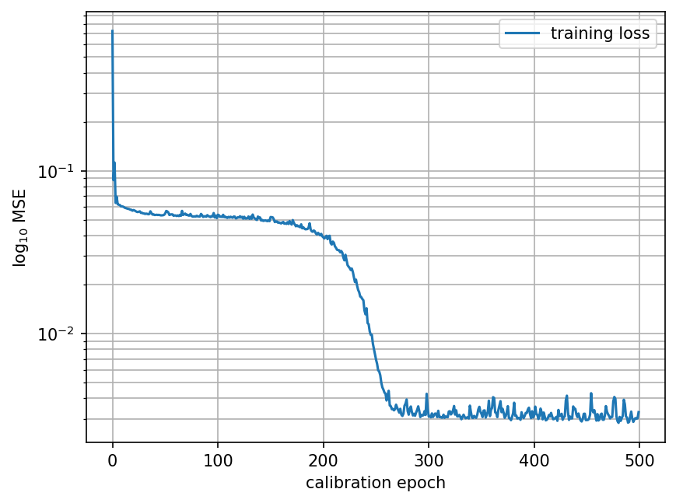
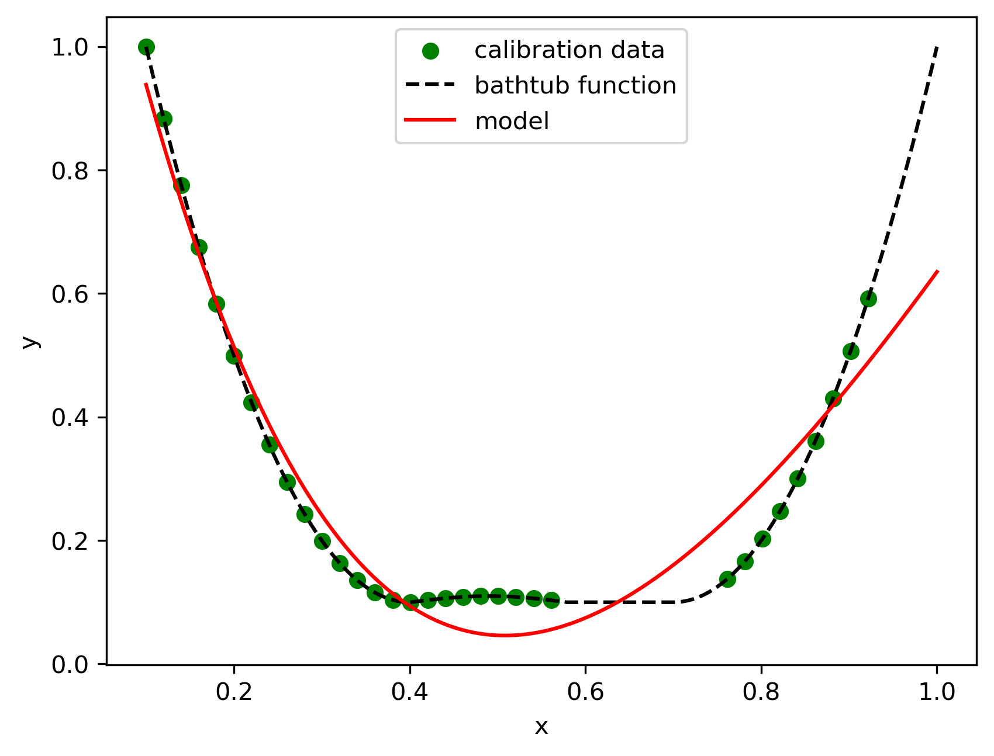
5. Compare FFNN with ICNN
500 epochs (2 layers, 16+16 nodes) FFNN
:

Slide 21
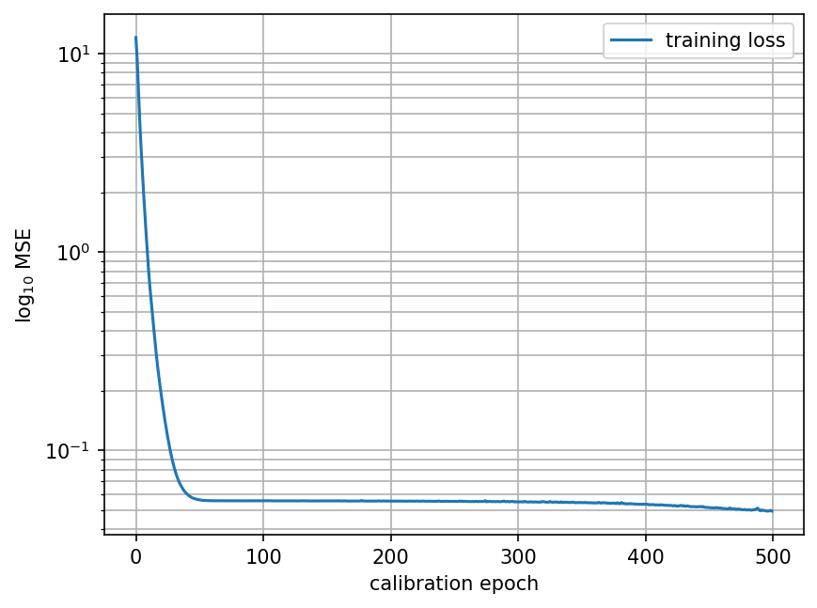
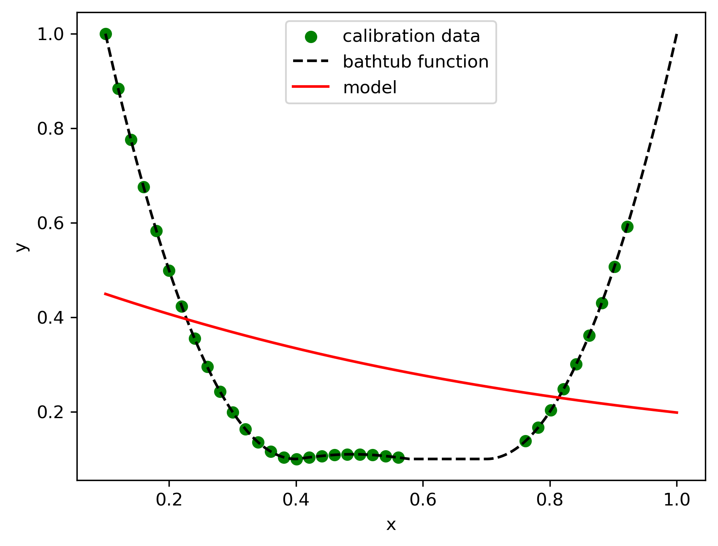
5. Compare FFNN with ICNN
500 epochs (2 layers, 16+16 nodes) ICNN(Softplus)

Slide 22
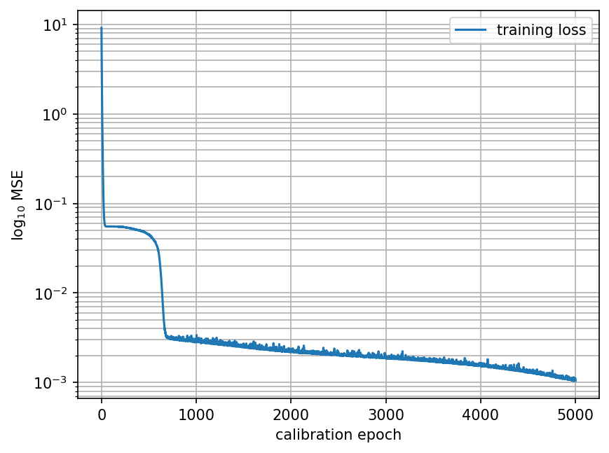
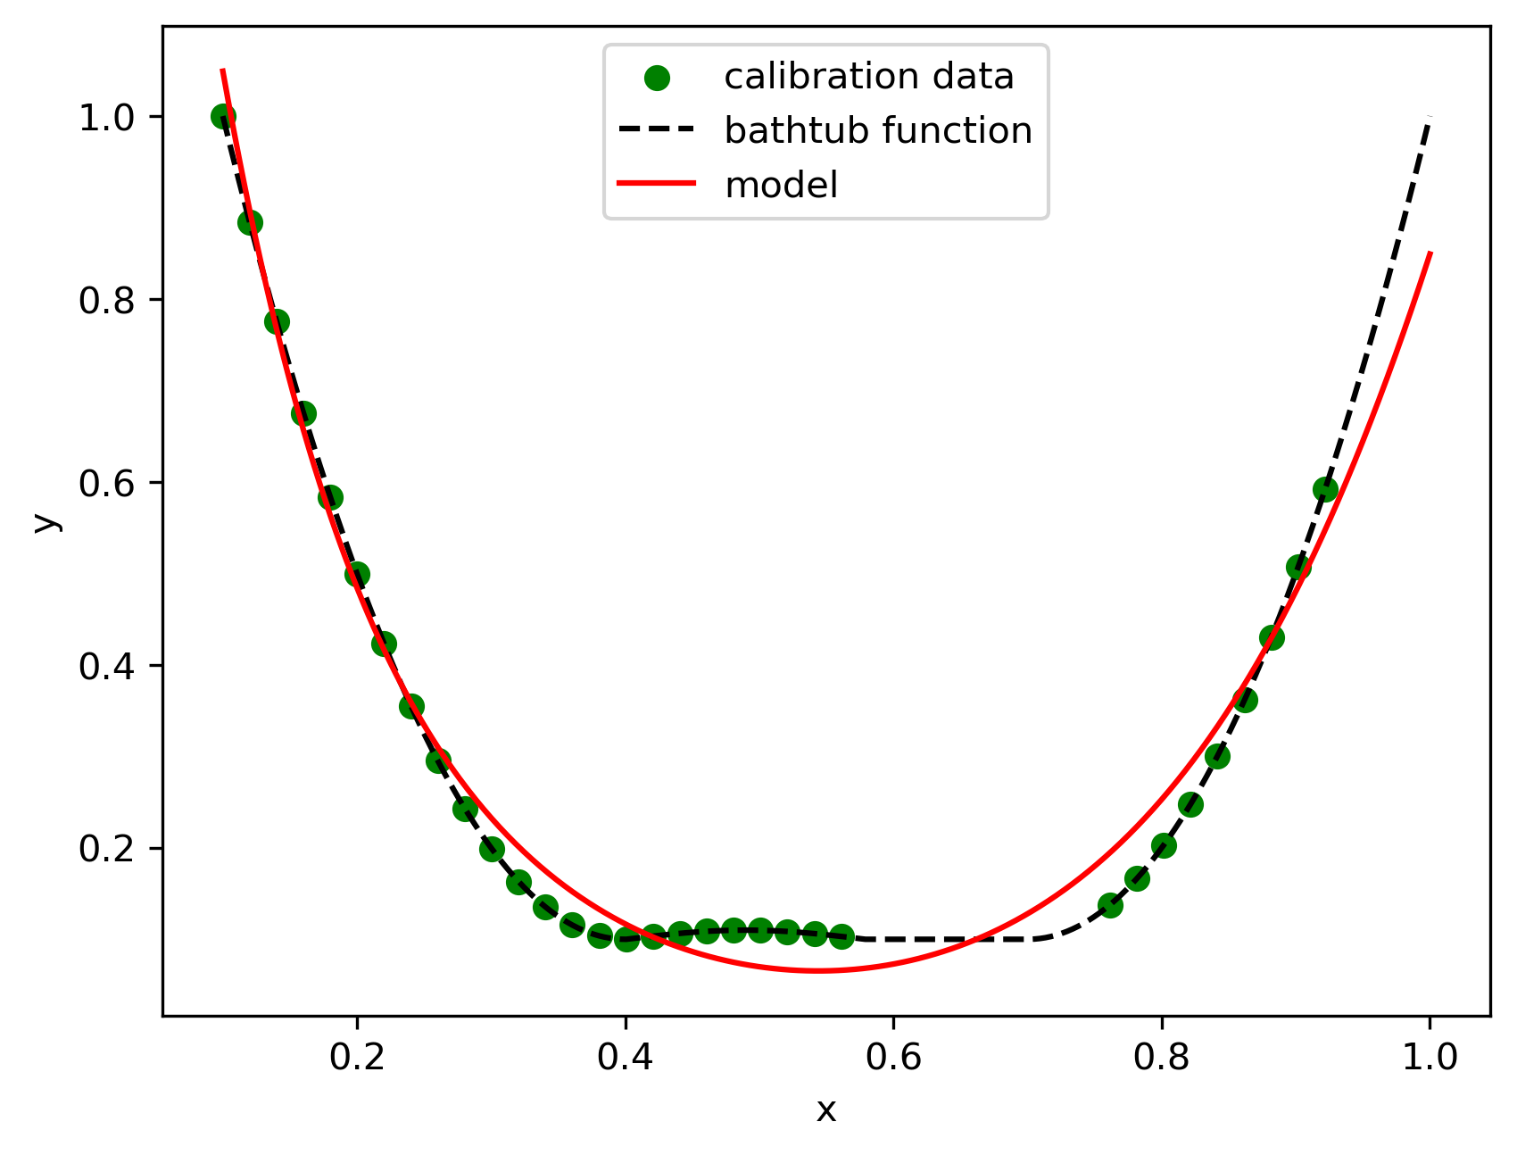
5. Compare FFNN with ICNN
5000 epochs (2 layers, 16+16 nodes) ICNN(Softplus)

Slide 23
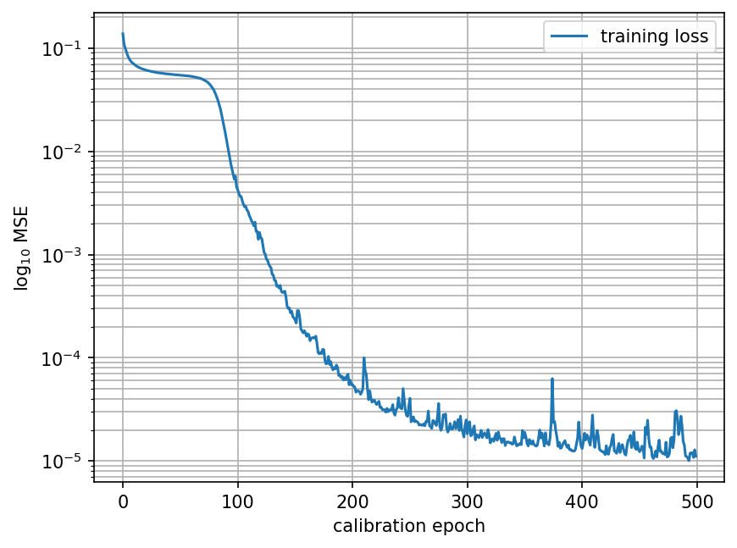
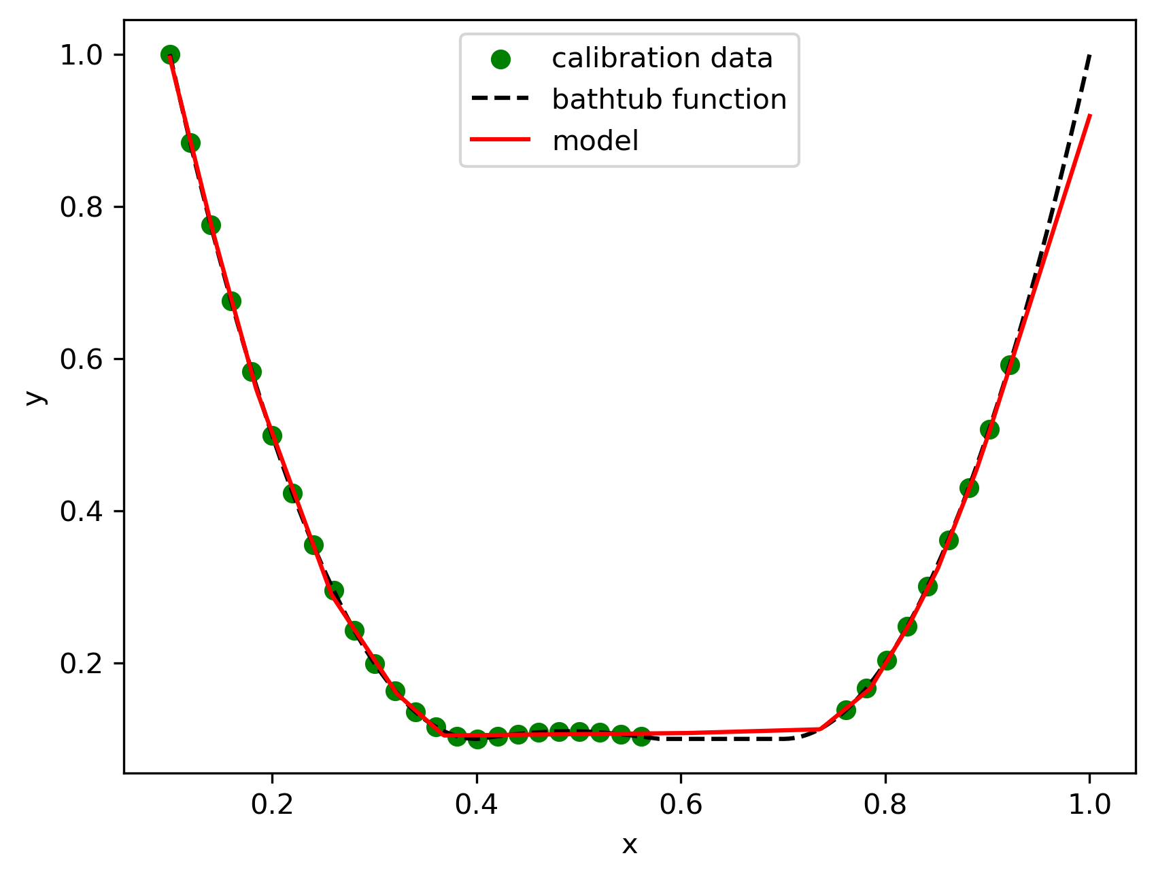
5. Compare FFNN with ICNN
500 epochs (2 layers, 16+16 nodes) ICNN(relu)

Slide 24
5. Compare FFNN with ICNN
Calibration :
FFNN learned quickly and reached a stable loss with 500 epochs, and it can handle non-linear function approximation well.
Longer training can benefit the ICNN by better fitting complex functions, albeit more slowly.
ICNN with ReLU activation is highly effective in learning and fitting the given function with fewer epochs compared to the Softplus variant.
FFNN provides better interpolation for complex functions with less training. ICNNs, however, offer stable and consistent outputs that might be more desirable for tasks needing convex constraints or more interpretable results.

Slide 25
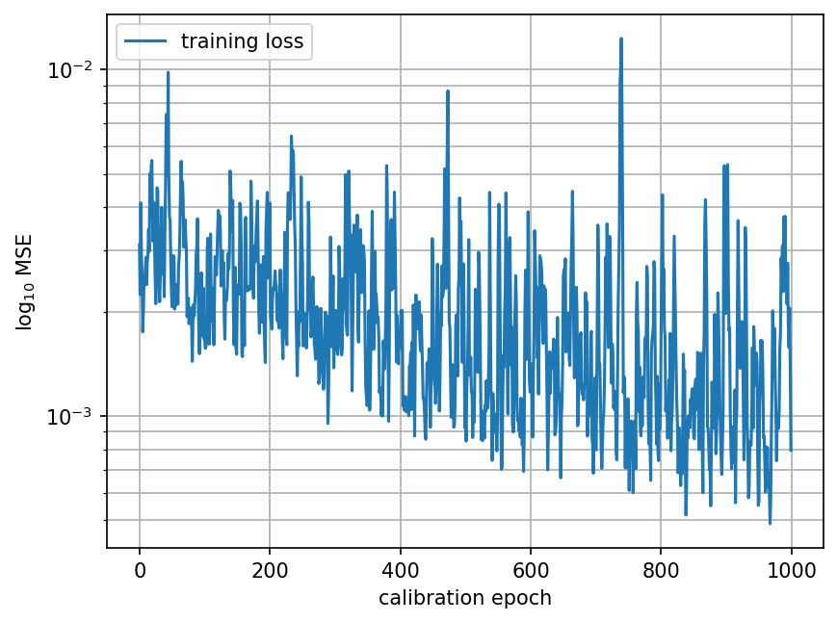
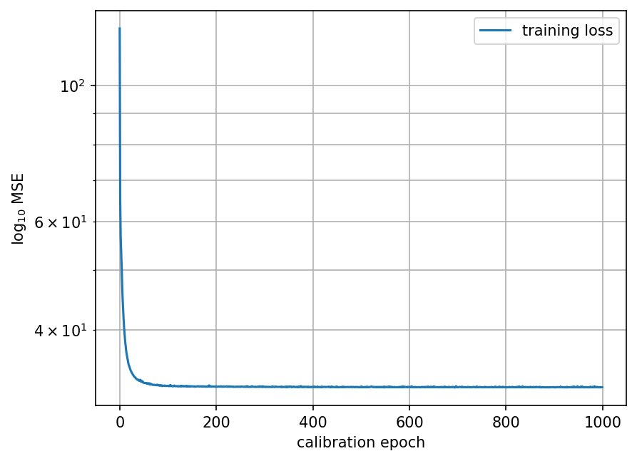
5. Compare FFNN with ICNN

Slide 26
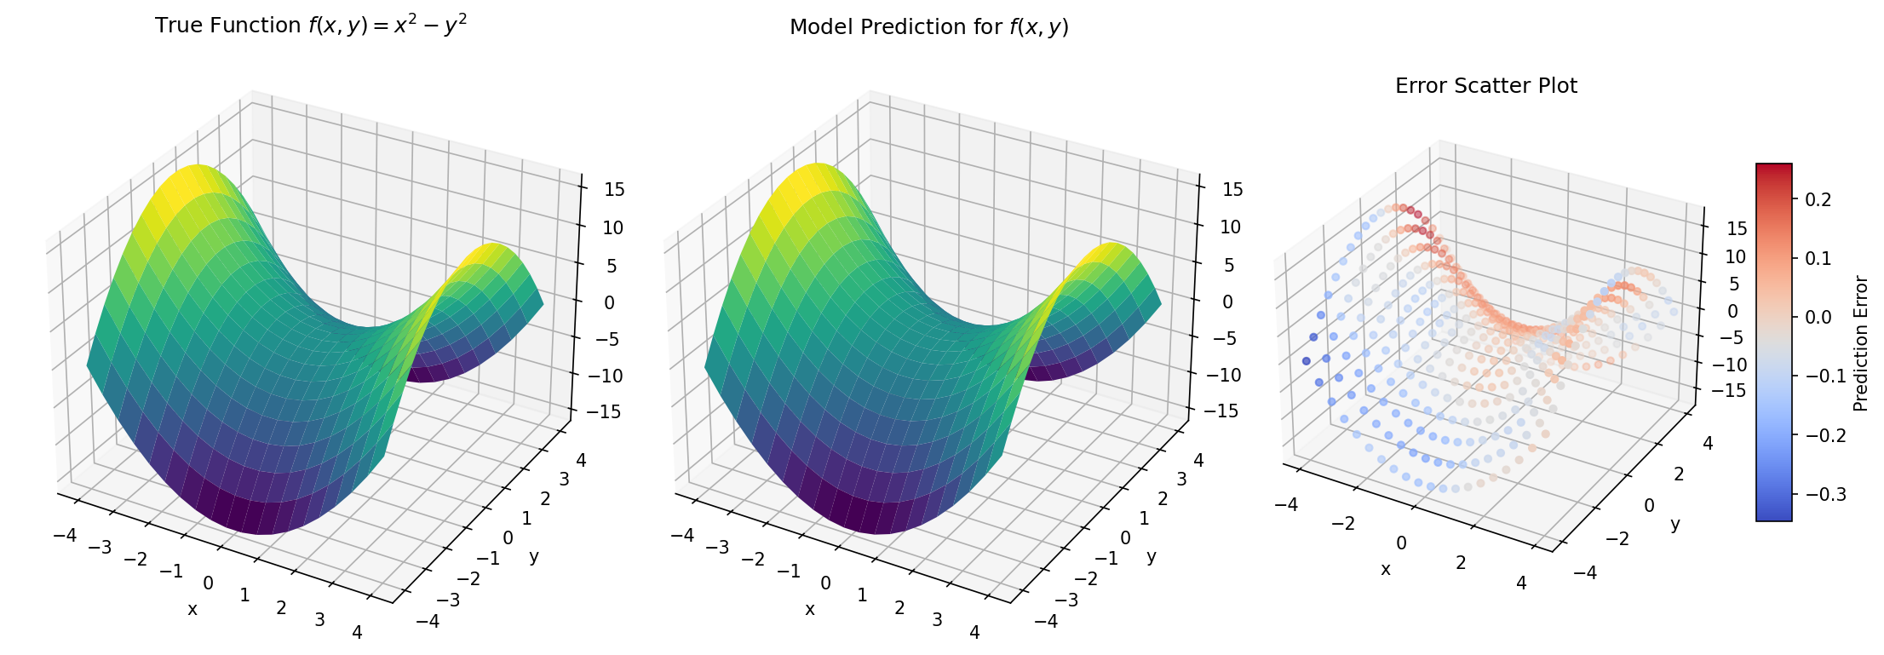
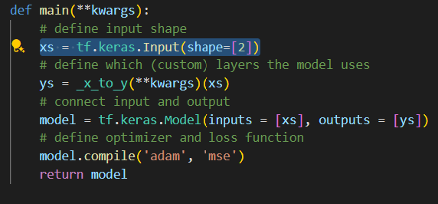
5. Compare FFNN with ICNN
inputs :1-dimensional
outputs:1-dimensional
inputs :2-dimensional
inputs :1-dimensional

Slide 27
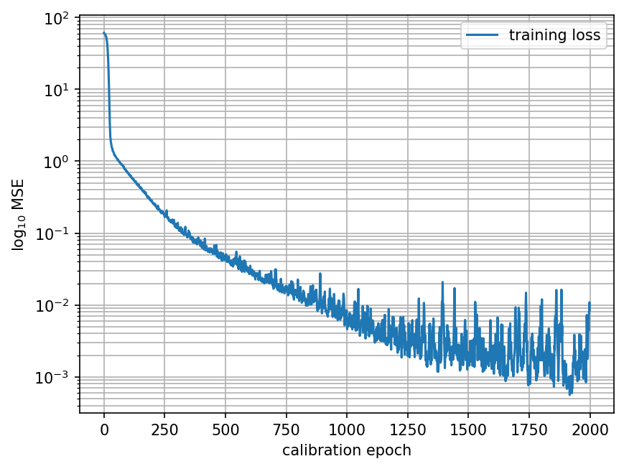
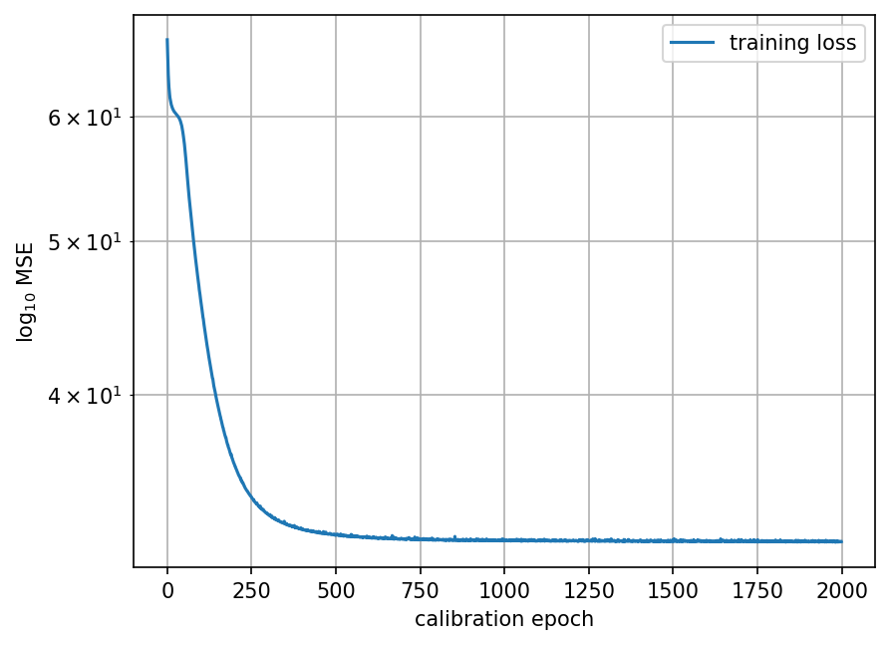
5. Compare FFNN with ICNN
500 epochs (2 layers, 16+16 nodes) for f1
FFNN

Slide 28
5. Compare FFNN with ICNN
500 epochs (2 layers, 16+16 nodes) FFNN for f1

Slide 29
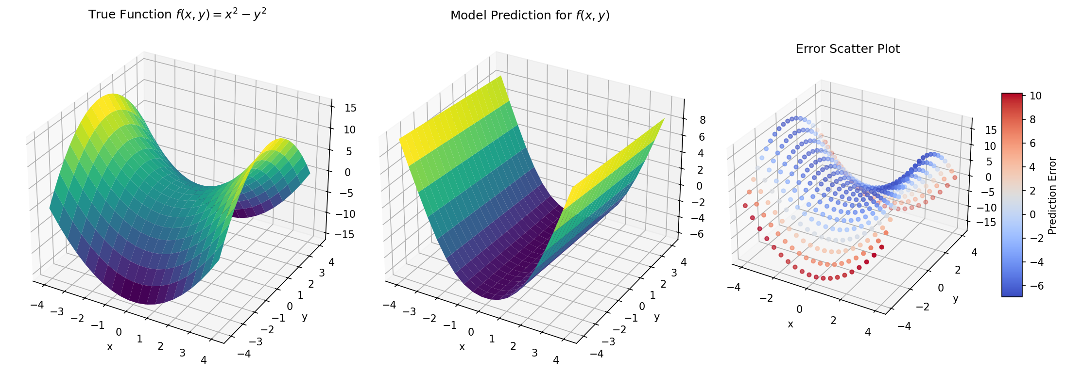
5. Compare FFNN with ICNN
500 epochs (2 layers, 16+16 nodes) ICNN for f1

Slide 30
5. Compare FFNN with ICNN
Observation :
When fitting f1, ICNN exhibit a bad fit. ICNN is more suitable for fitting convex functions and has better generalisation ability, while FFNN is more flexible.
FFNN may suffer from overfitting and unstable optimisation

Slide 31
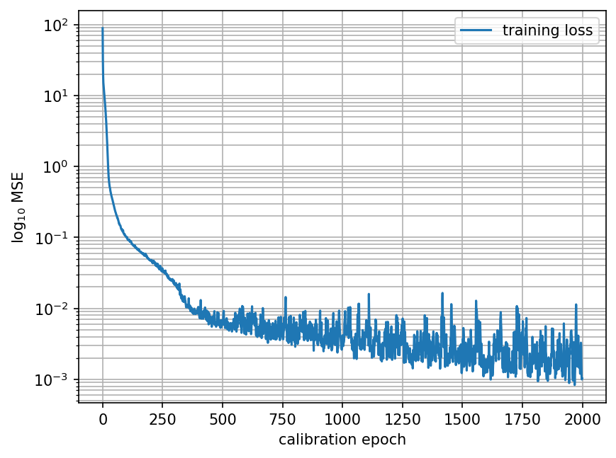
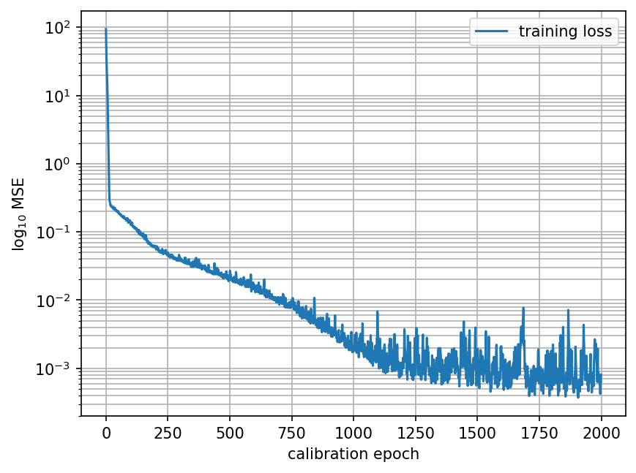
5. Compare FFNN with ICNN
500 epochs (2 layers, 16+16 nodes) for f2
FFNN
ICNN

Slide 32
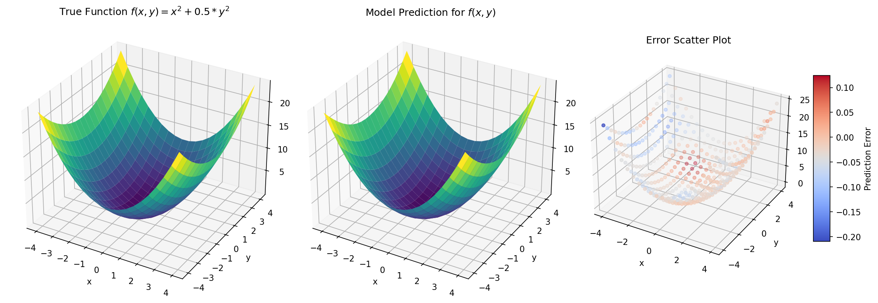
5. Compare FFNN with ICNN
2000 epochs (2 layers, 16+16 nodes) FFNN for f2

Slide 33

5. Compare FFNN with ICNN
500 epochs (2 layers, 16+16 nodes) ICNN for f2

Slide 34
5. Compare FFNN with ICNN
Observation :
ICNN is more suitable for fitting convex functions and has better generalisation ability

Slide 35
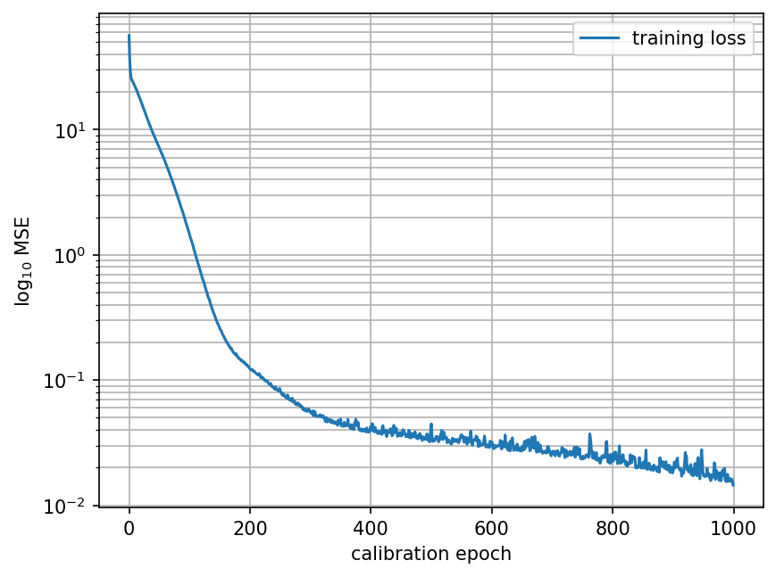
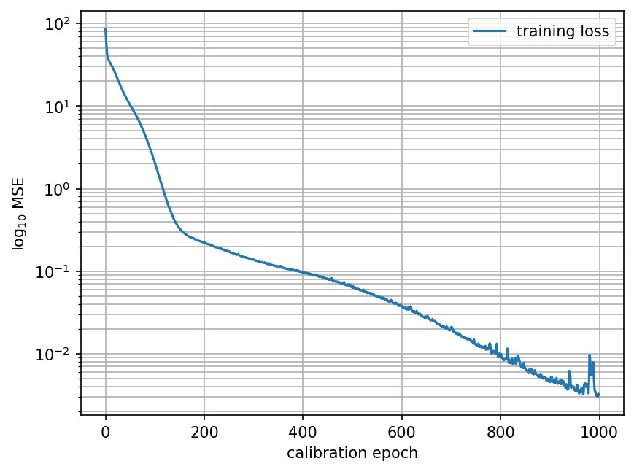
6. Sobolev training

Slide 36
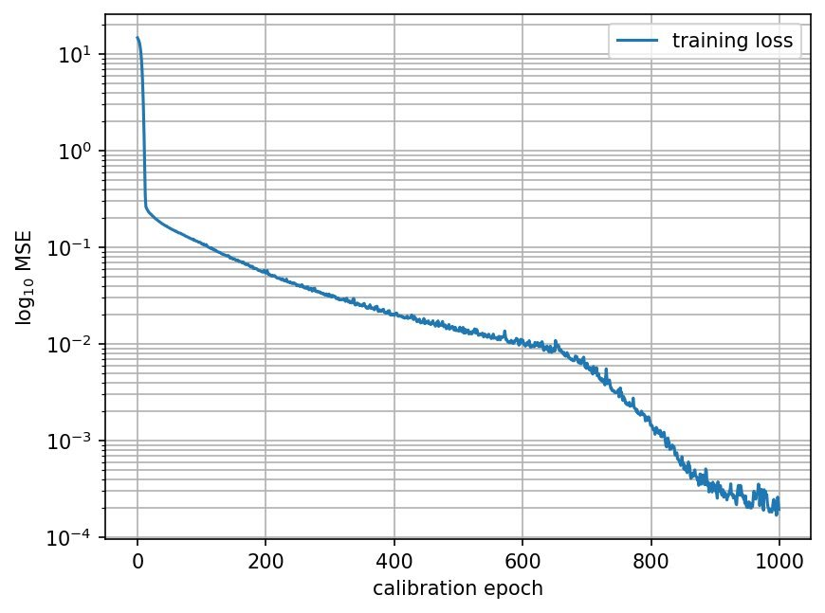
6. Sobolev training
Observation :
Sobolev training typically reduces the oscillations of the model, resulting in a smoother prediction curve, which improves the predictive stability on unknown inputs.

Slide 37
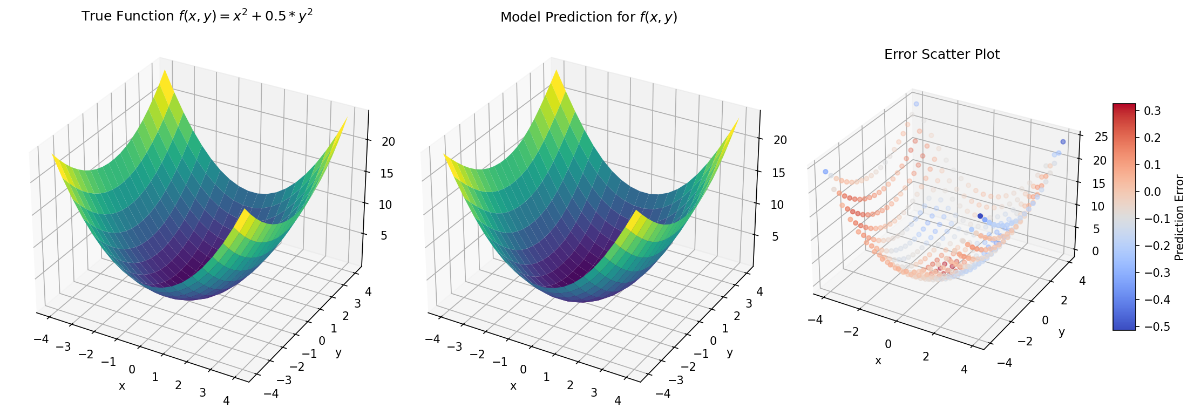
6. Sobolev training
Calibration on f2

Slide 38
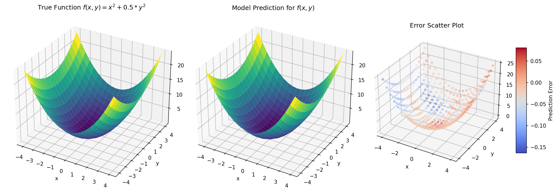
6. Sobolev training
Calibration on f2 and its gradient.

Slide 39

6. Sobolev training
Calibration only on the gradient.

Slide 40
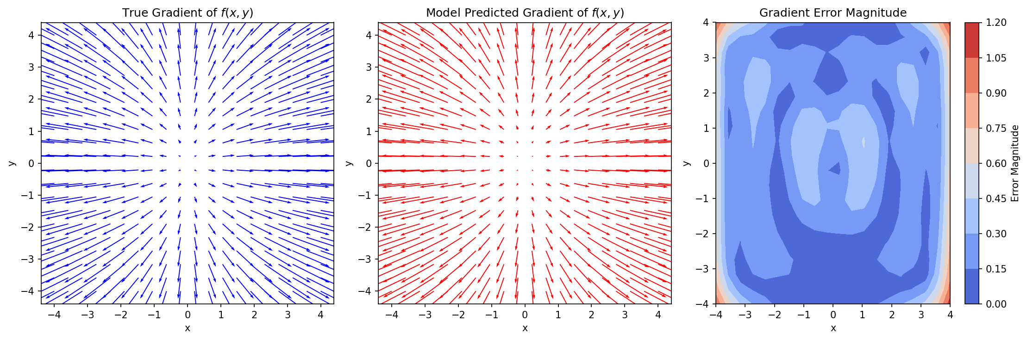
6. Sobolev training
Calibration on f2

Slide 41

6. Sobolev training
Calibration on f2

Slide 42

6. Sobolev training
Calibration on f2

Slide 43
6. Sobolev training
Observation :
Sobolev training is a higher-order learning method that combines function value and derivative information to give the model better generalisation to points outside the training data distribution. By calibrating the gradient, the model not only learns the distribution of the output values, but also captures locally varying features in the input space.

Slide 44
Danke
Runze Chen, Sushanth Gandepalli, Akshata Gundeti, Huasen Luo,
Ria Shete, Sudheerkumar Vardham, Xin Xiong

